Slide 1


National Preparedness Month 2022
Engagement Toolkit
National Preparedness Month 2022 Theme
A Lasting Legacy: The life you’ve built is worth protecting. Prepare for disasters to create a lasting legacy for you and your family.

Slide 2
About the HBCU Emergency Management Workforce Consortium
Our Why
Recent natural disasters primarily weather related have highlighted the limited emergency response training that has been provided to students at HBCUs in vulnerable geographic areas. In probing the lack of training afforded students at HBCU it was also evident that HBCU graduates do not have a significance presence in emergency management careers. The HBCU Emergency Management Consortium was started and addressed as its initial undertaking the emergency response training needs among students at Historically Black Colleges and Universities (HBCUs).
Our Goal:
To boost engagement of HBCUs and their students in the field of emergency management.
Learn More About the HBCU Emergency Management Consortium

Slide 3

National Preparedness Month
2022 Theme: A Lasting Legacy
This year’s National Preparedness Month campaign will feature a call to action for the Black and African American community.
This year’s national public service announcements are being developed and will be released throughout the country this September, to help get preparedness information into the hands of those who live in underserved communities.
“The life you’ve built is worth protecting. Prepare for disasters to create a lasting legacy for you and your family.”

Slide 4
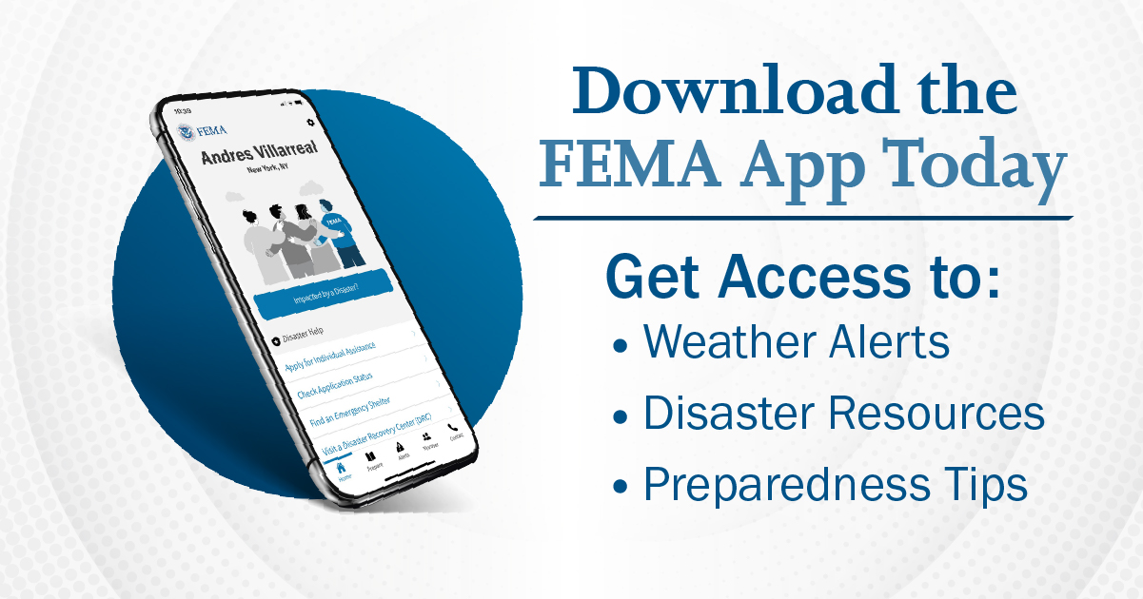
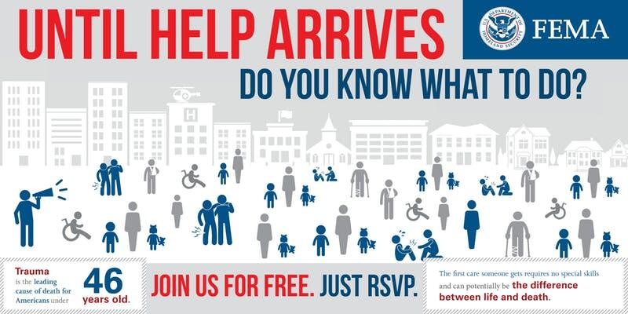


Key Calls to Action for HBCU EMWC in September
Encourage Students to Download Campus Safety and/or FEMA App
Encourage students and faculty to complete a citizen responder training
Encourage Campus Leadership to Conduct a Table-Top Exercise
Create, amplify and share social media content promoting disaster preparedness
Host a Campus Preparedness Workshop or Activity

Slide 5
Timeline
Date | Activity
August 25 | HBCU Emergency Management Workforce Consortium Receives National Preparedness Month Toolkit
August 31 | HBCU Emergency Management Workforce Consortium Call
September 1 | National Preparedness Month Launch Events at HBCU EMW Consortium Member Campuses and Social Media Channels
Week of September 22 | National HBCU Week Conference + National Preparedness Month Social Media Push
February 2023 | Black History Month Preparedness Event (Details TBD)

Slide 6

National Preparedness Month Resources
National Preparedness Month Social Media Graphics
National Preparedness Month Animated Graphics
National Preparedness Month Social Media Toolkit
Personal Disaster Preparedness for People with Disabilities Social Media Toolkit
Individuals with Disabilities
Social Media Preparedness Toolkits | Ready.gov

Slide 7
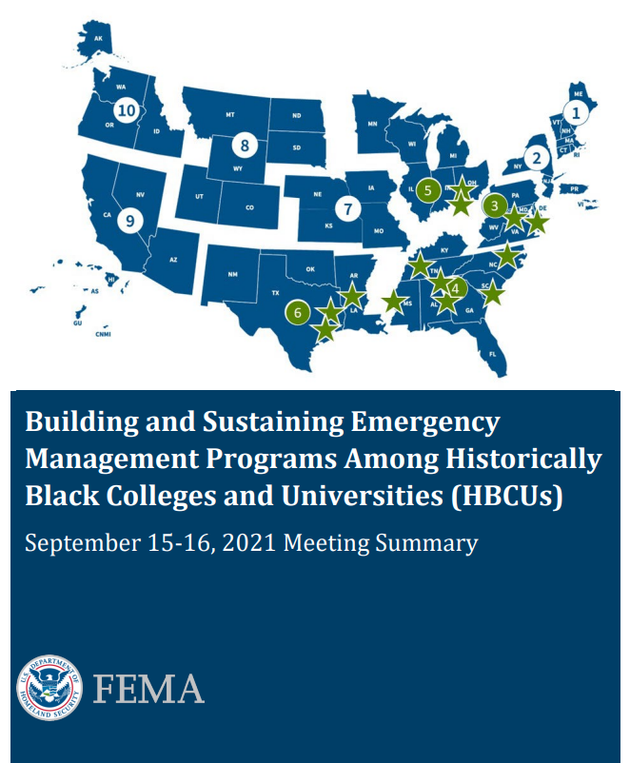
Emergency Preparedness
Resources and Information for Historical Black Colleges and Universities
Building and Sustaining Emergency Management Programs Among Historically Black Colleges and Universities (HBCUs)
Ready Campus | Ready.gov
CISA Tabletop Exercise Packages (CTEPs)
Academic Engagement | Homeland Security (dhs.gov)
FEMA Higher Education Program | FEMA Higher Education Program
White House Initiative on Advancing Educational Equity, Excellence, and Economic Opportunity through Historically Black Colleges and Universities | U.S. Department of Education
Click Here to Access

Slide 8
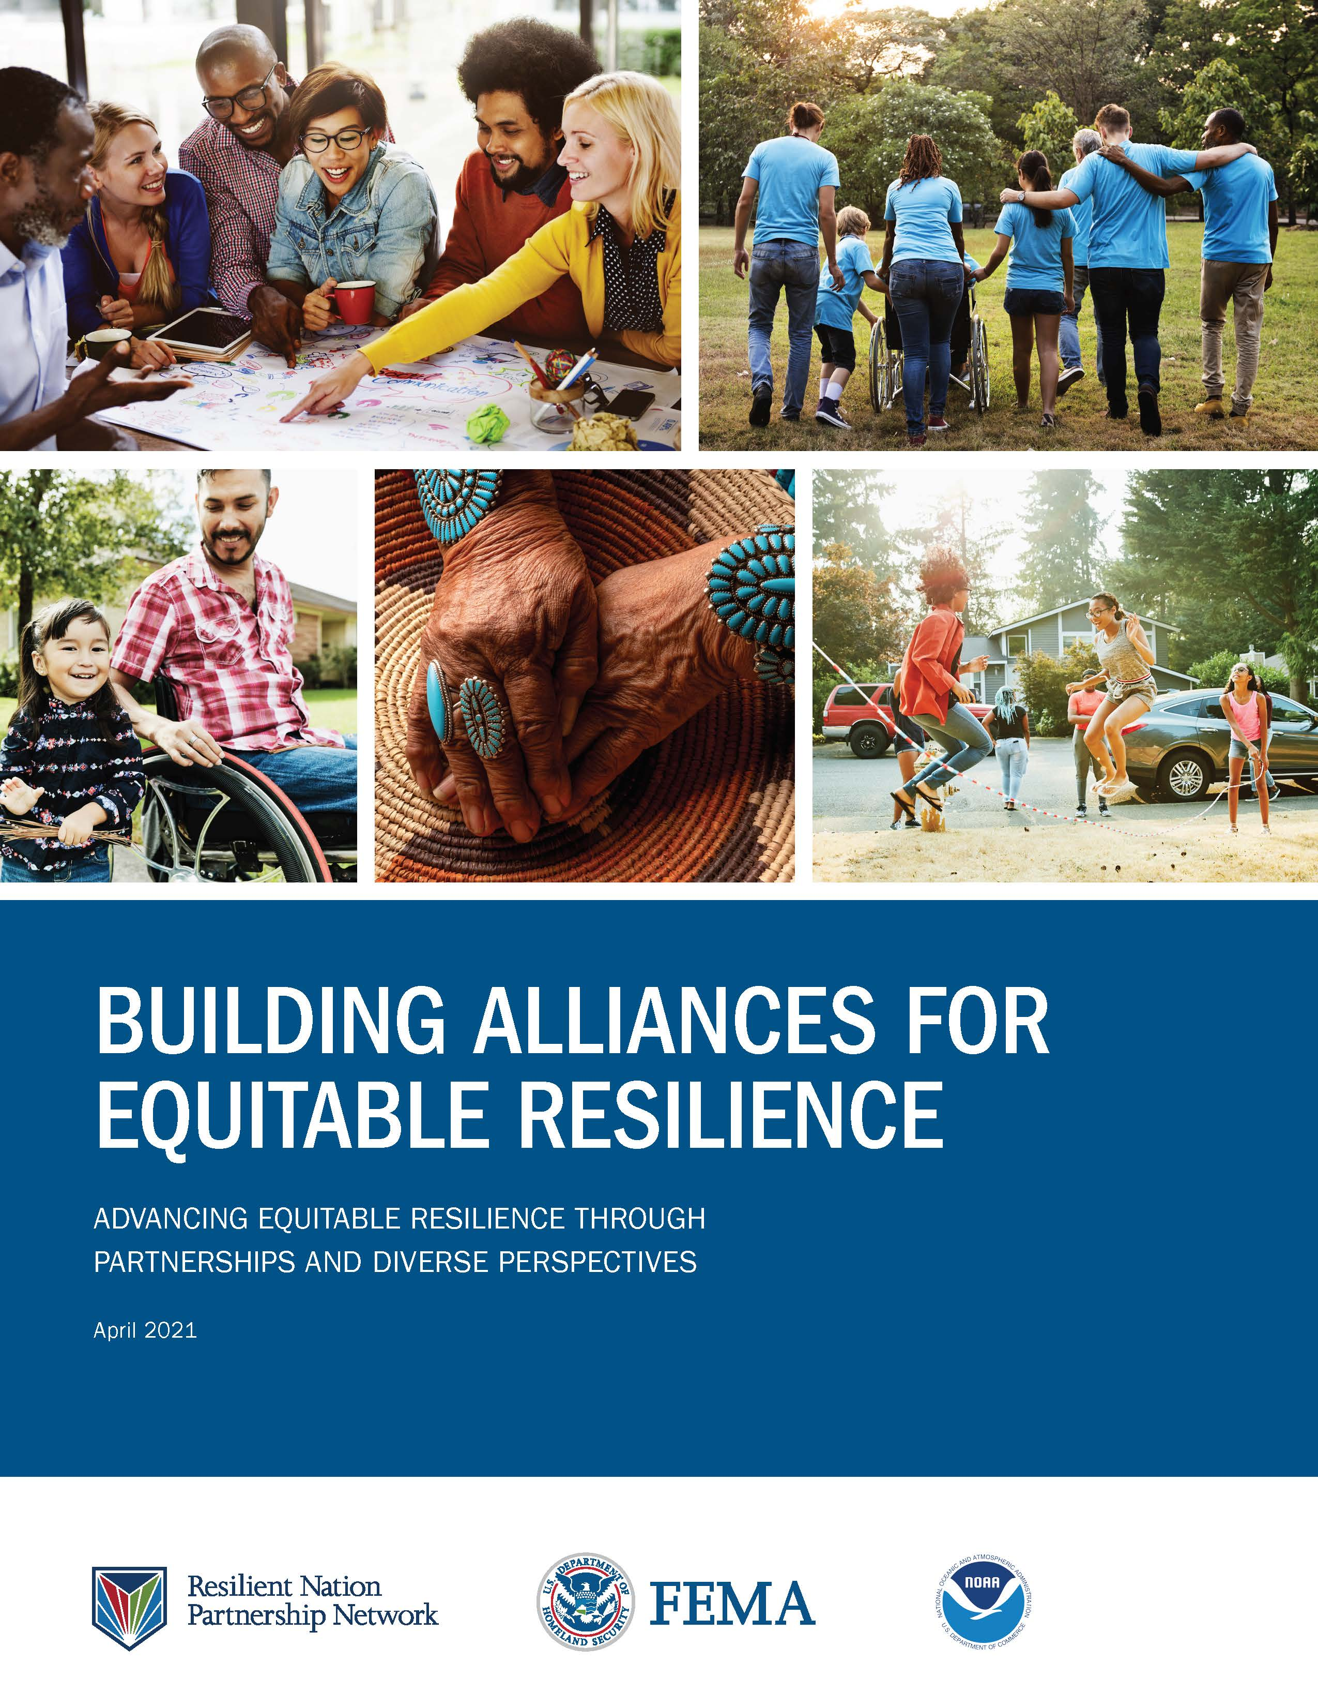
Additional Partners and Sources of Information
Homepage - The Chisholm Legacy Project
Center for Disaster Philanthropy - Center for Disaster Philanthropy
Institute for Diversity and Inclusion in Emergency Management
National CERT Association
National Household Survey | FEMA.gov
Building Alliances for Climate Action
Building Alliances for Equitable Resilience

Slide 9
Contact Slide Option 2
HBCU Emergency Management Consortium
National Preparedness Month Point of Contacts
Ariel Triplet, ariel.wilson@howard.edu
Marcus Coleman, Marcus.Colemanjr@fema.dhs.gov
National Preparedness Month | Ready.gov

